Slide 1

INTRO TO SOFTWARE ENGINEERING
GROUP PROJECT: VIDEO GAME TRACKER

Slide 2
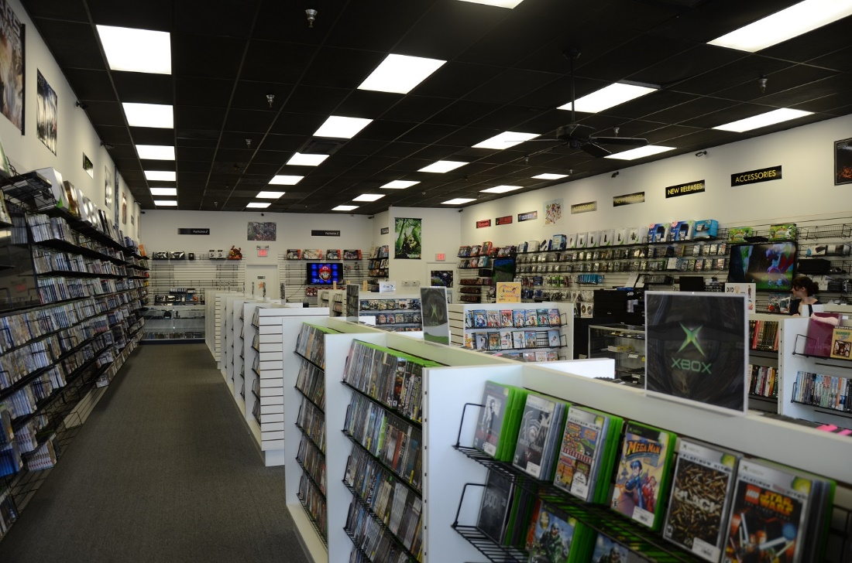











VIDEOGAME TRACKER
LINKING USERS TO
GAMES THEY’LL ENJOY
THE RIGHT GAME FOR
THE RIGHT PERSON

Slide 3
VIDEOGAME TRACKER
3-PILAR SYSTEM
VIDEO GAME TRACKER
GAME FINDER
DEMOGRAPHIC PROFILE
DIRECTORY
MAGIC 8-BALL
USER ENTERS DEMOGRAPHIC INFORMATION
OR
USER ANSWERS QUESTIONS
ADVANCED SEARCH
SEARCH NAME
PROGRAM USES THE ANSWERS TO FILTER A SELECTION
FILTER OPTIONS AND LIST OF GAMES
PROGRAM STORES DEMOGRAPHIC INFORMATION AND LINKS TO ORDER CONFIRMATIONS
INFORMATION ABOUT THE GAME THAT IS USEFUL TO THE USER
PROGRAM SELECTS A GAME FOR THE USER
ORDER VIDEO GAME
3
*FOR EDUCATIONAL PURPOSES ONLY

Slide 4


VIDEOGAME TRACKER
HOMESCREEN SCREENSHOT
INSERT SCREENSHOT
CLEAN
PROFESSIONAL
USER-INTERFACE
4
*FOR EDUCATIONAL PURPOSES ONLY

Slide 5
VIDEOGAME TRACKER
FUNCTIONAL REQUIREMENTS
WHAT IT DOES
WHEN IT’S AVAILABLE
MODES OF OPERATION
DETERMINE VIDEOGAME SELECTION
MATCH GAME WITH WANTS AND NEEDS
KEEP TRACK OF STORE INVENTORY
TAILOR STORE INVENTORY
GATHER DEMOGRAPHIC INFORMATION
INITIAL RELEASE ASAP
GAME FINDER IS OPERATIONAL IMMEDIATELY
AVAILABLE IMMEDIATELY BUT FUNCTIONAL WHEN OWNER ENTERS INVENTORY
WILL NEED USAGE OF PROGRAM TO TAILOR INVENTORY BASED ON DEMOGRAPHICS
AVAILABLE ACROSS ALL PLATFORMS
LAPTOP, PC, TABLET, MOBILE, IN-STORE
CONVENIENTLY ACCESSABLE TO ANY USER AND THEIR PLATFORM OF CHOICE
5
*FOR EDUCATIONAL PURPOSES ONLY

Slide 6
VIDEOGAME TRACKER
FUNCTIONAL REQUIREMENTS (CONT’D)
TRANSOFRMATIONS
REACTION TO STIMULI
RETENTION OF DATA
FRONT END:
HTML, JAVASCRIPT, AJAX, JQUERY, CSS, AND BOOTSTRAP
BACK END:
PHP AND MYSQL
LINEAR USER INTERFACE
MINIMAL USER-MADE CHOICES
RELIABILITY DEPENDS ON STORE OWNER INVENTORY UPDATES
CAN BE USED FOR PEOPLE WITH LITTLE OR ADVANCED GAMING KNOWLEDGE
DATA RETAINED IN DEMOGRAPHIC PROFILES
MAGIC-8 BALL GAME SELECTION
FUTURE UPDATES:
MOST BOUGHT GAMES
NEW RELEASES
CLASSICS
6
*FOR EDUCATIONAL PURPOSES ONLY

Slide 7

VIDEOGAME TRACKER
NON-FUNCTIONAL REQUIREMENTS
PERFORMANCE
DELIVERING A PROGRAM CLIENTS WILL SAY IS “GOOD” AND “FAST”
CONSTRAINTS
EFFICIENCY MEASURES
FLOW OF DATA
DEMOGRAPHIC PROFILES
QUANTITY OF GAMES
REPROGRAMMING WITH EACH UPDATE
DEMOGRAPHIC PROFILE DOES NOT FOLLOW USER
NARROW CHOICES WITH EACH MAGIC 8-BALL QUESTION
DATABASE MAINTENANCE
USER INPUT
LINKING PURCHASE WITH DEMOGRAPHIC INFORMATION
FUTURE UPDATE: BEST SELLERS, NEW RELEASE, ETC.
6
*FOR EDUCATIONAL PURPOSES ONLY

Slide 8

VIDEOGAME TRACKER
NON-FUNCTIONAL REQUIREMENTS
USABILITY AND
HUMAN FACTORS
A DESIGN MADE EASY-TO-USE
REQUIRED TRAINING
USING THE SYSTEM
DIFFICULTY IN MISUSE
LITTLE TO NO TRAINING NEEDED
QUESTION & ANSWER
3 PILAR SYSTEM
MINIMAL KNOWLEDGE REQUIRED
TOUCH BASED KEYBOARD OPTION
LINEAR USAGE
EASY TO ANSWER QUESTIONS
EASY TO READ INFORMATION
ABILITY TO “GO BACK”
PROMT SCREEN BEFORE PURCHASE
6
*FOR EDUCATIONAL PURPOSES ONLY
Notes:
. Little to no training needed since the system is so easy to use.
. The data that the user needs to enter in all 3 pillars of the system is very basic:
Demographic Profile: asks users about himself.
Magic 8-Ball: asks users what kind of games he’s looking for.
Directory: allows users to look up games using a Search or Advanced Search function.
. Easy to use the system.
. Touch-based with a digital keyboard.
. Extremely difficult for users to misuse the system:
- Questions presented to users by the system are straightforward.
- Information presented to users is easy to understand.
- Search and Advanced Search functions work in accordance to what the user types in.
. Complication: touch-based user interface might be too sensitive to the user’s touch.

Slide 9

VIDEOGAME TRACKER
NON-FUNCTIONAL REQUIREMENTS
MAINTAINABILITY
RESTORING AND IMPROVING THE SYSTEM WITH EASE
IMPROVING THE SYSTEM
FUTURE OF THE SYSTEM
PORTING THE SYSTEM
IMPROVEMENTS IN LIGHT OF ERRORS
ADDING/GROWING GAME DATABASE
ADDING FEATURES WHERE IT MAKES SENSE
QUARTERLY UPDATES
CLICK & PLAY DEMOS
INNOVATION WITH FUTURE TECHNOLOGIES
LINEAR USAGE
. VERY EASY PORTABILITY.
. ACHIEVED BY REPLACING PROGRAMMING LANGUAGE COMPILER WITH ANOTHER FOR THE SAME LANGUAGE; WON’T DEGRADE SYSTEM’S FUNCTIONS.
6
*FOR EDUCATIONAL PURPOSES ONLY
Notes:
. Maintenance is essential for:
Correcting any errors that
might show up in the system before, during, and after it’s used daily, or whenever possible.
Improving the system in
light of certain errors.
Updating the system
either quarterly, seasonally, or yearly depending on preference. Done by putting a list of future games in the database as soon as they’re announced and making demos of them available ASAP.
Adding new features to
the system as soon as it becomes possible to do so; should be easy to do in order to keep up with the times.
Making it very easy to
port the system from one platform to another.

Slide 10

VIDEOGAME TRACKER
NON-FUNCTIONAL REQUIREMENTS
PRECISION & ACCURACY
A SYSTEM THAT IS ALWAYS ON TARGET
DEGREE OF ACCURACY
DEGREE OF PRECISION
ENSURING ACCURACY
. EXTREMELY ACCURATE DATA CALCULATIONS.
GREATEST DEGREE OF
PRECISION POSSIBLE REGARDING DATA CALCULATIONS.
. USING TRY/EXCEPT CLAUSES INITIALLY TO ENSURE ACCURACY.
. TESTING MAY SHOW THAT DIFFERENT METHODS MAY BE REQUIRED.
6
*FOR EDUCATIONAL PURPOSES ONLY
Notes:
. Data calculations must be extremely accurate and made to the greatest degree of precision possible for several reasons:
Inaccuracies regarding
information about what games are out there would mislead users.
Accurate data calculations
regarding how many user profiles there are would let developers know when to increase memory space.
- Data regarding who bought, ordered, or pre-ordered which game must be very accurate

Slide 11

VIDEOGAME TRACKER
NON-FUNCTIONAL REQUIREMENTS
SECURITY
PROTECT THE WEBSITE FROM BEING HACKED OR INFECTED
VALIDATION
DATABASE SECURITY
ACCESS CONTROL
FIELD IN THE FORM ARE REQUIRED.
VALIDATION WILL BE SERVER-SIDE.
AJAX FOR IMMEDIATE FEEDBACK.
PROTECT SQL INJECTION ATTACK.
REMOVE UNUSED STORED PROCEDURE IN THE DATABASE.
AVOID BRUTE FORCE ATTACK
ALLOW COOKIES
6
*FOR EDUCATIONAL PURPOSES ONLY

Slide 12

VIDEOGAME TRACKER
NON-FUNCTIONAL REQUIREMENTS
RELIABILITY & AVAILABILITY
CONSTANTLY PERFORM PROPERLY
RELIABILITY
AVAILABILITY
RELIABILITY STABILITY
FREE OF TECHNICAL ERRORS.
LINKING WITH OTHER SITE.
IMPROVING THE DESIGN.
AUTOMATIC BACKUP.
DATA ARCHIVING.
RESISTANCE TO FAILURE.
6
*FOR EDUCATIONAL PURPOSES ONLY

Slide 13

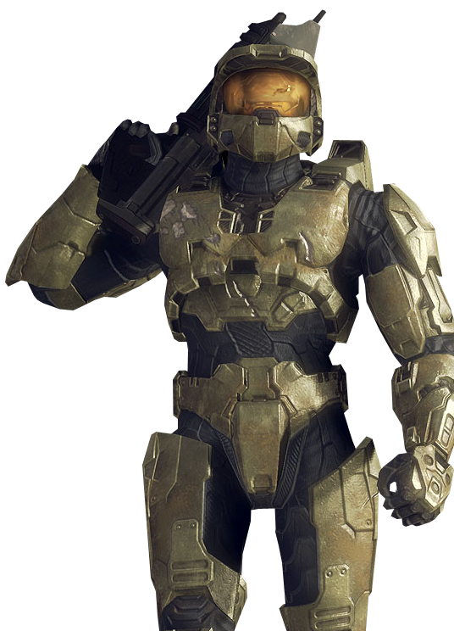


VIDEOGAME TRACKER
NON-FUNCTIONAL REQUIREMENTS
ACTIVITY | START WEEK | SLACK
Requirements Analysis | Week 4 | Continuous Revision
System Design | Week 5
Program Design | Week 6 & 7
Research of Games | Week 8
Program Implementation | Week 9-13 | No Slack
Testing
Delivery | Week 14 | No Slack
Maintenance | Quarterly
6
*FOR EDUCATIONAL PURPOSES ONLY

Slide 14

VIDEOGAME TRACKER
QUESTIONS???
HOW CAN WE IMPROVE???
6
*FOR EDUCATIONAL PURPOSES ONLY

Slide 15

THANK YOU!
JAMES JEANNIS, ROBERTO HERNANDEZ, ARI BUTOWSKY & THOMAS MILGREW

